Slide 1
DESIGN PATTERNS
By Eduard Luchuk

Slide 2
AGENDA
Patterns overview
Classification of patterns
Creational patterns
Structural patterns
Behavioral patterns

Slide 3
PATTERNS OVERVIEW
Design patterns are typical solutions to commonly occurring problems in software design. They are like pre-made blueprints that you can customize to solve a recurring design problem in your code.

Slide 4
PATTERNS OVERVIEW
Why should we learn patterns?
Design patterns are a toolkit of tried and tested solutions to common problems in software design.
You make fewer calculations when designing, using standard unified solutions, because all hidden problems have already been found.
Design patterns define a common language that you and your teammates can use to communicate more efficiently.

Slide 5
CLASSIFICATION OF PATTERNS
Patterns
by level
by intent or purpose
low-level patterns are often called idioms
high-level patterns are architectural patterns
creational patterns
structural patterns
behavioral patterns

Slide 6
CREATIONAL PATTERNS
Creational patterns provide object creation mechanisms that increase flexibility and reuse of existing code.
Creational patterns
Factory method
Abstract factory
Prototype
Builder
Singleton

Slide 7
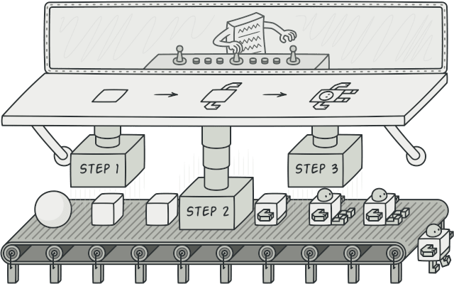
BUILDER
Builder is a creational design pattern that lets you construct complex objects step by step. The pattern allows you to produce different types and representations of an object using the same construction code.

Slide 8
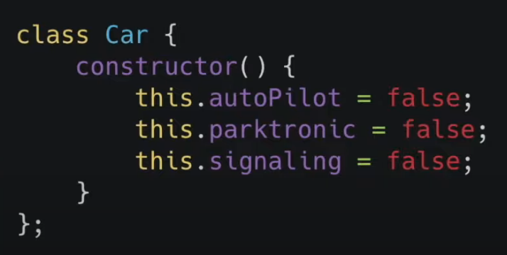
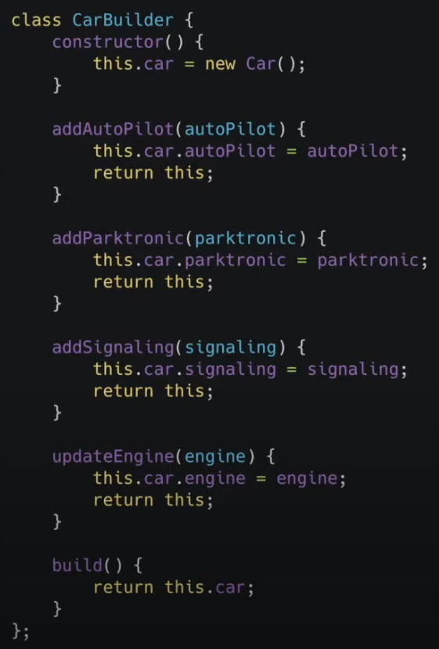
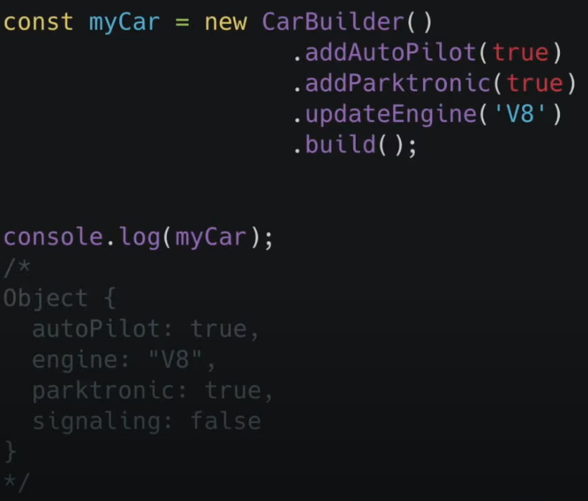
BUILDER

Slide 9
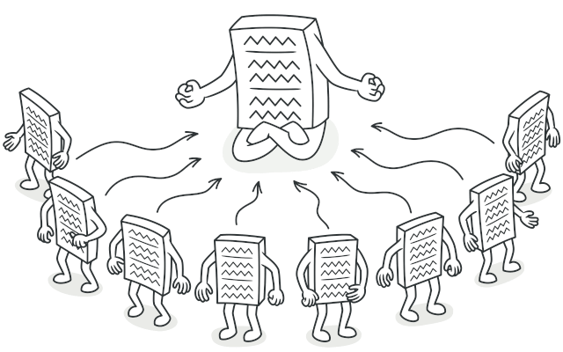
SINGLETON
Singleton is a creational design pattern that lets you ensure that a class has only one instance, while providing a global access point to this instance.

Slide 10
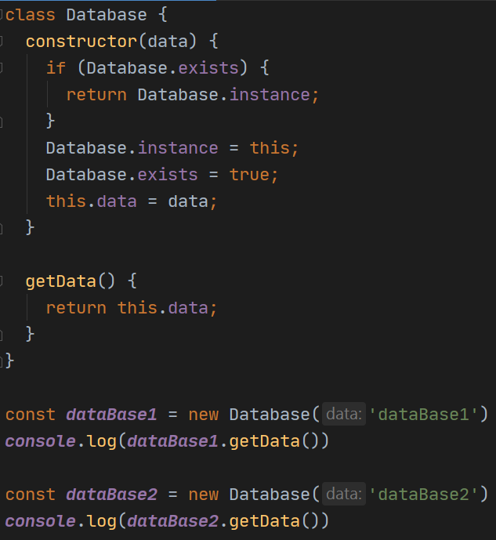
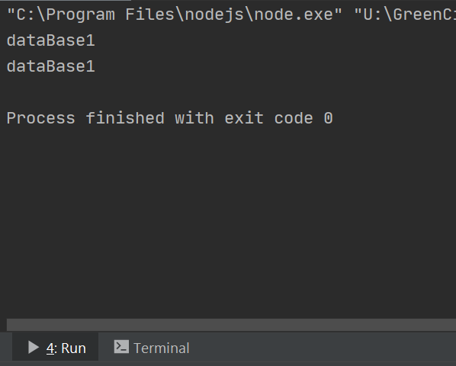
SINGLETON

Slide 11
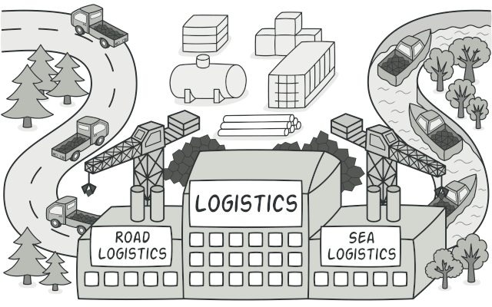
FACTORY METHOD
Factory Method is a creational design pattern that provides an interface for creating objects in a superclass, but allows subclasses to alter the type of objects that will be created.

Slide 12
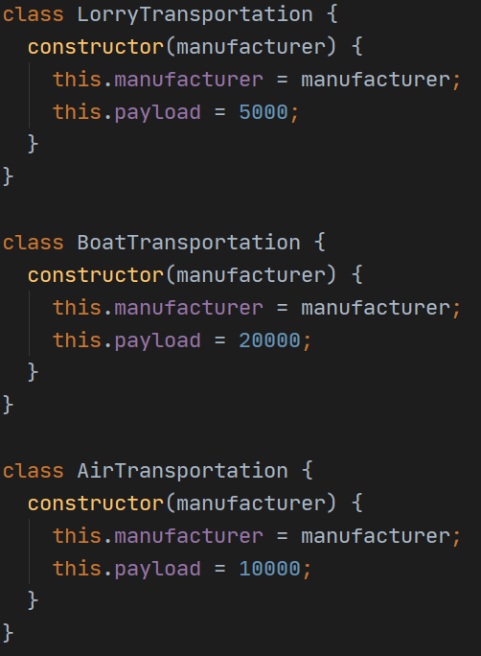
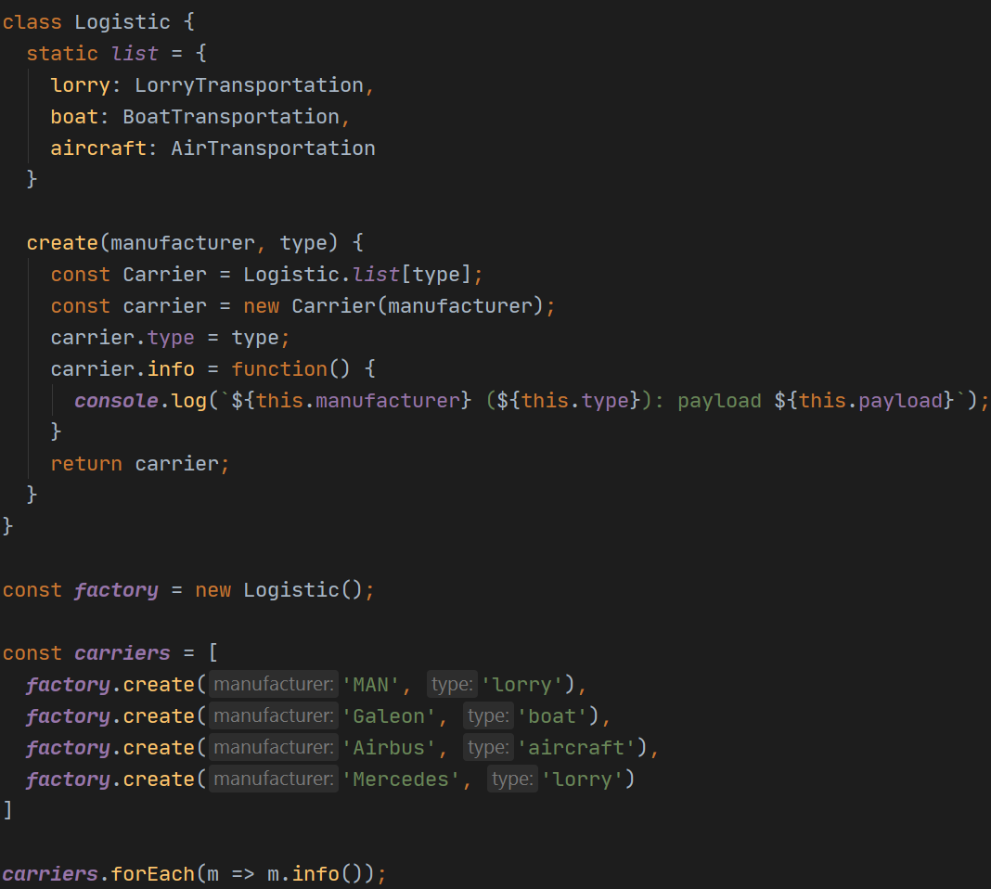
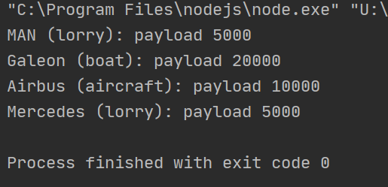
FACTORY METHOD

Slide 13
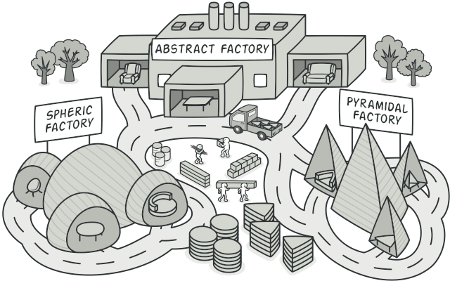
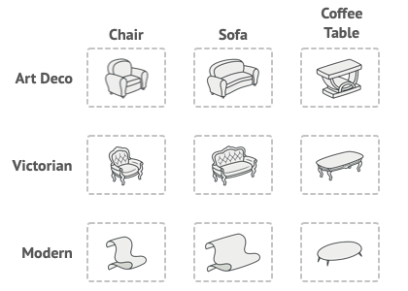
ABSTRACT FACTORY
Abstract Factory is a creational design pattern that lets you produce families of related objects without specifying their concrete classes.

Slide 14
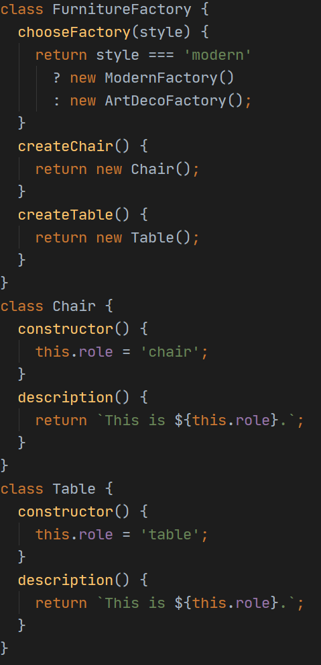
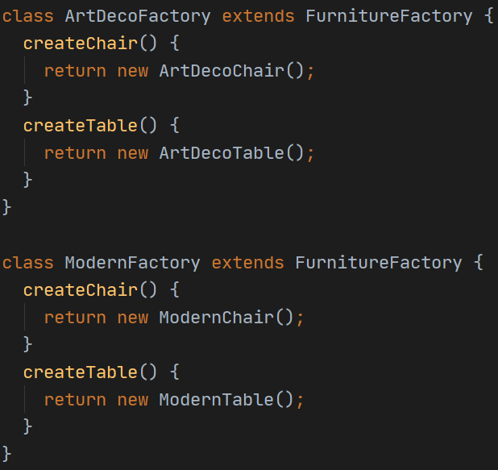
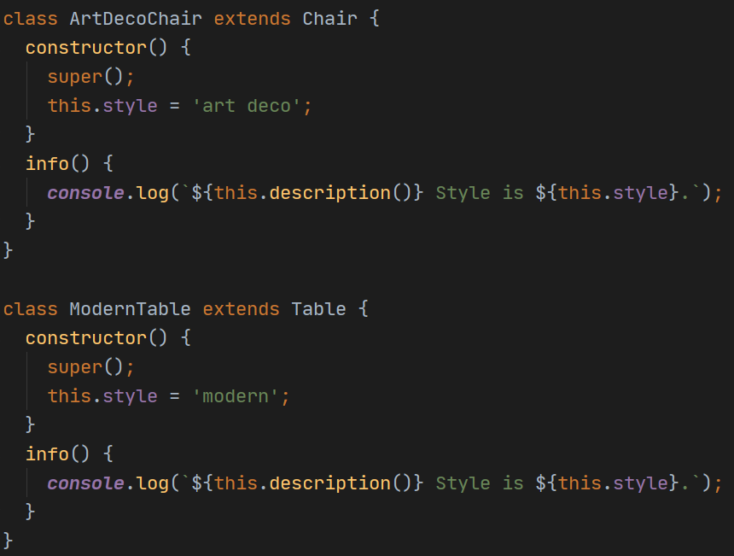
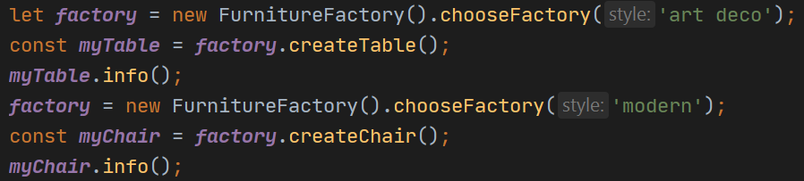
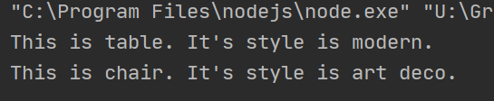
ABSTRACT FACTORY

Slide 15

PROTOTYPE
Prototype is a creational design pattern that lets you copy existing objects without making your code dependent on their classes.

Slide 16
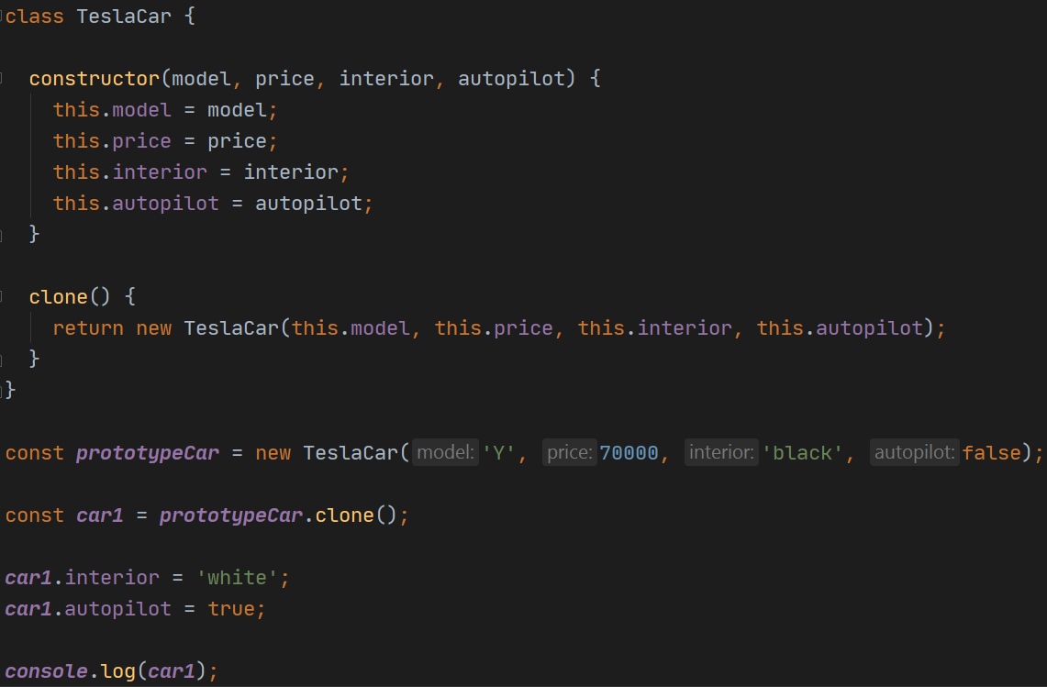
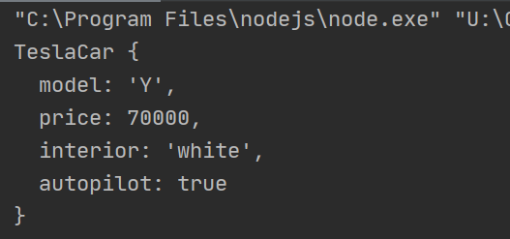
PROTOTYPE

Slide 17
STRUCTURAL PATTERNS
Structural patterns explain how to assemble objects and classes into larger structures, while keeping the structures flexible and efficient.
Structural patterns
Adapter
Bridge
Composite
Decorator
Facade
Flyweight
Proxy

Slide 18
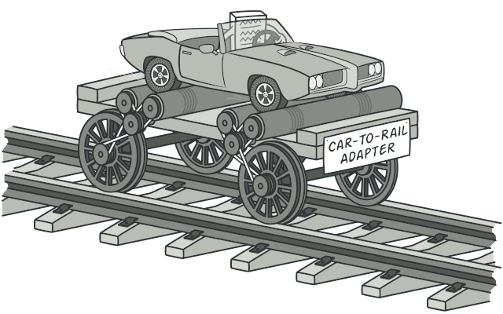
ADAPTER
Adapter is a structural design pattern that allows objects with incompatible interfaces to collaborate.

Slide 19
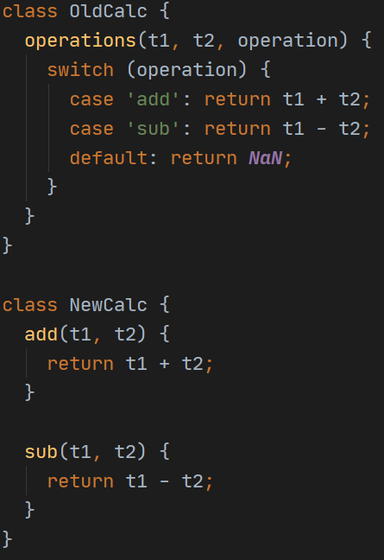
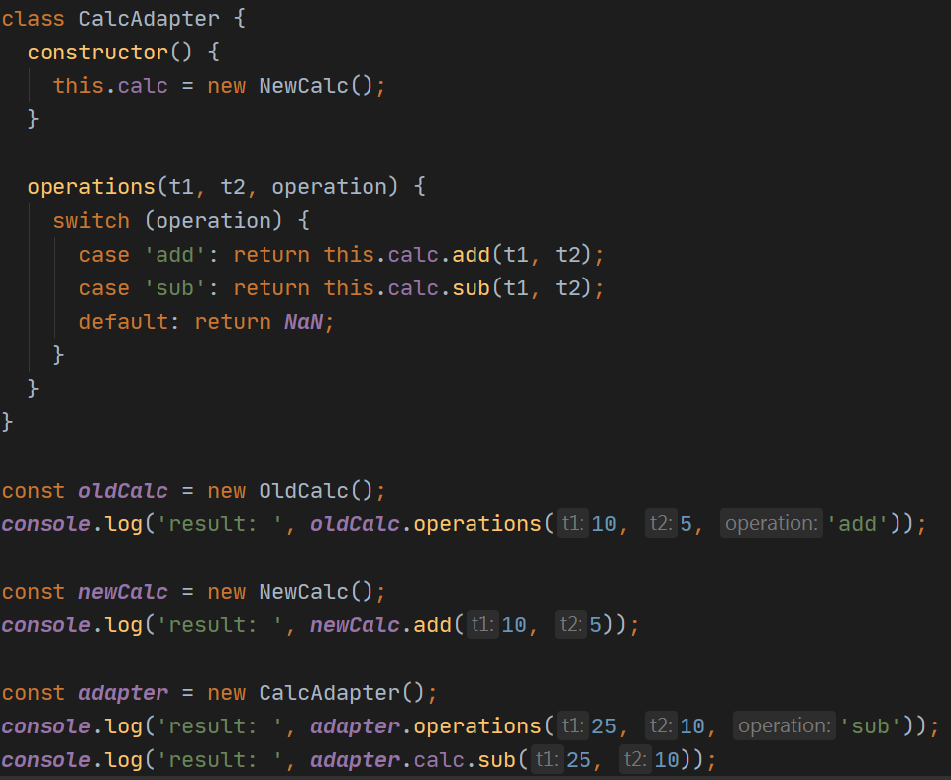
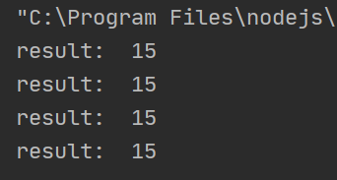
ADAPTER

Slide 20
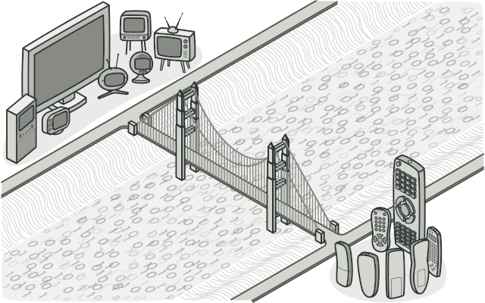
BRIDGE
Bridge is a structural design pattern that lets you split a large class or a set of closely related classes into two separate hierarchies – abstraction and implementation – which can be developed independently of each other.

Slide 21
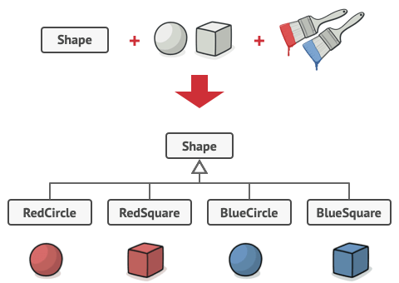
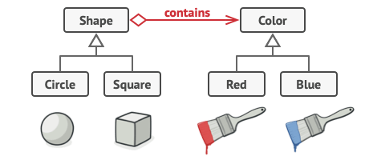
BRIDGE
issue
solution

Slide 22
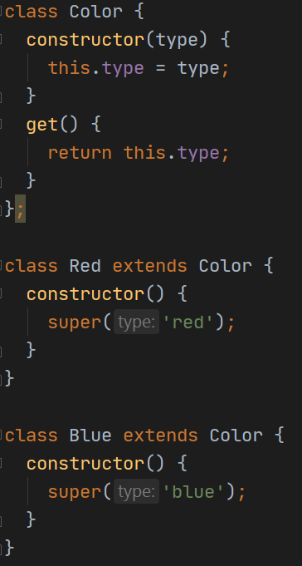
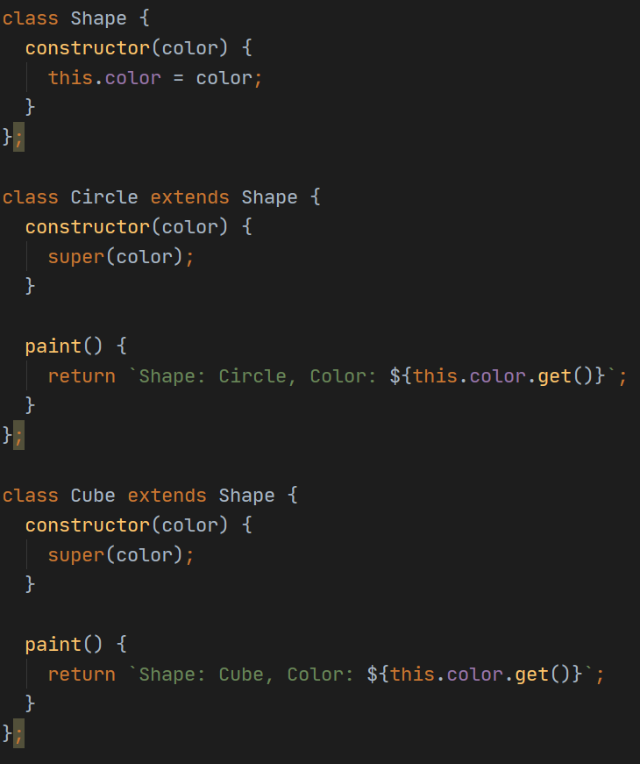
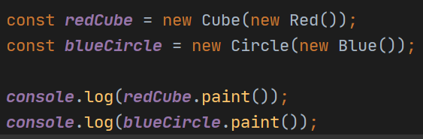
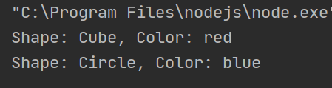
BRIDGE

Slide 23
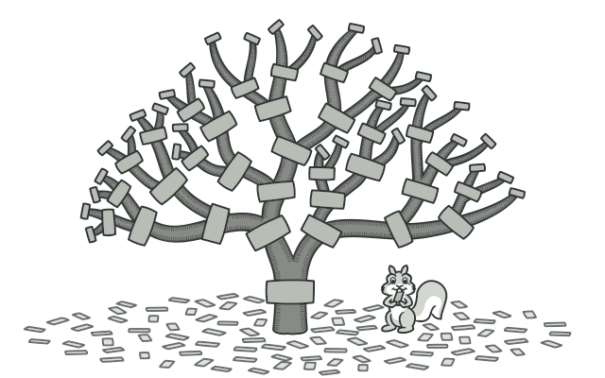
COMPOSITE
Composite is a structural design pattern that lets you compose objects into tree structures and then work with these structures as if they were individual objects.

Slide 24
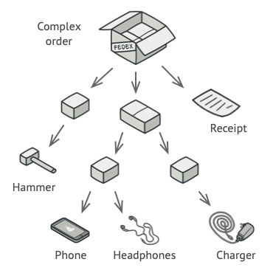
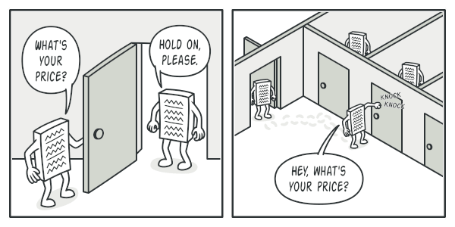
COMPOSITE

Slide 25
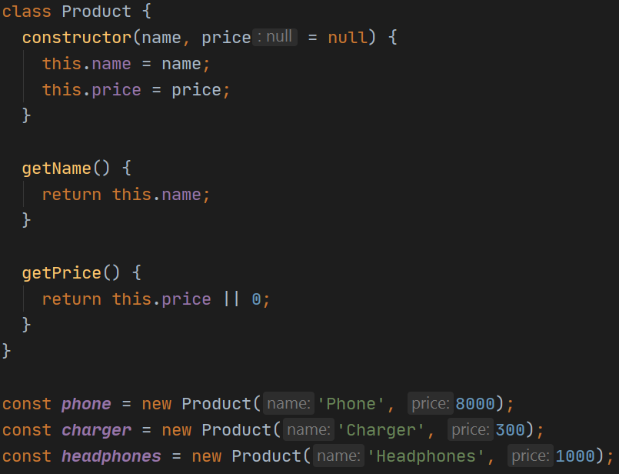
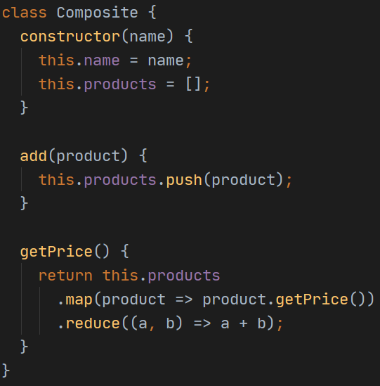
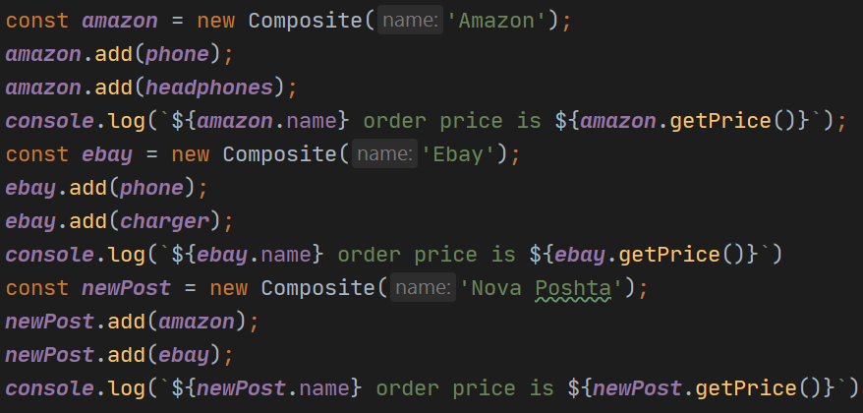
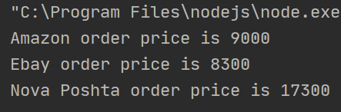
COMPOSITE

Slide 26
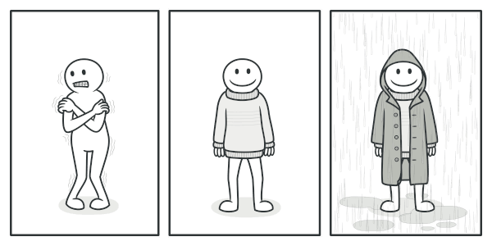
DECORATOR
Decorator is a structural design pattern that lets you attach new behaviors to objects by placing these objects inside special wrapper objects that contain the behaviors.

Slide 27
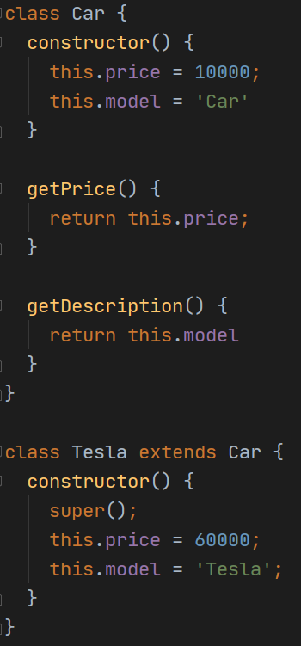
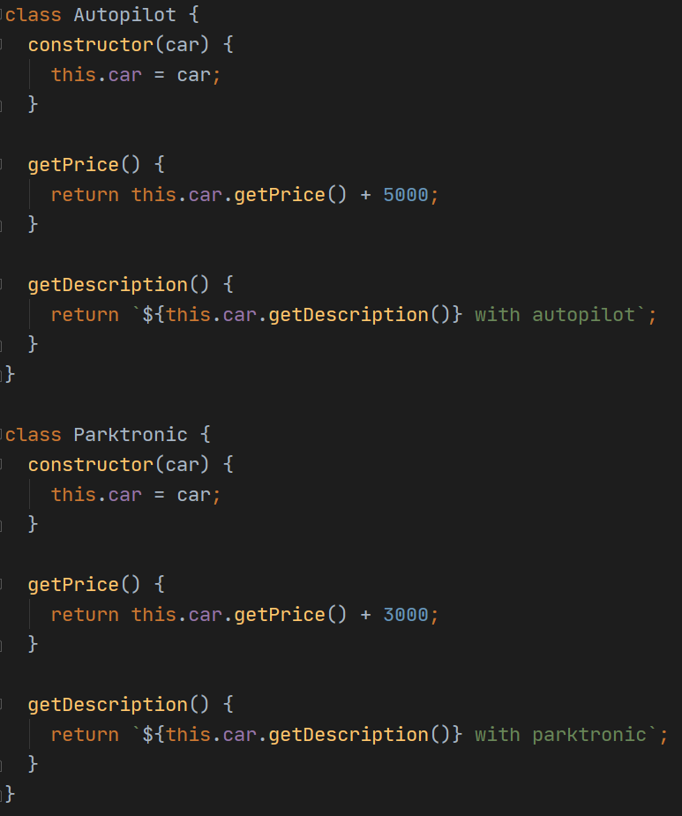
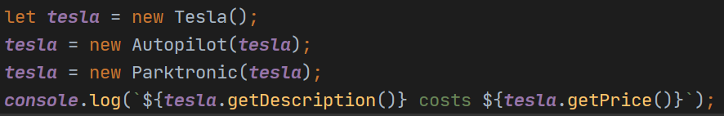
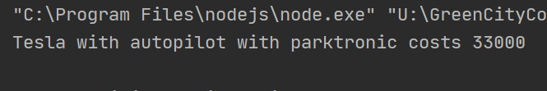
DECORATOR

Slide 28
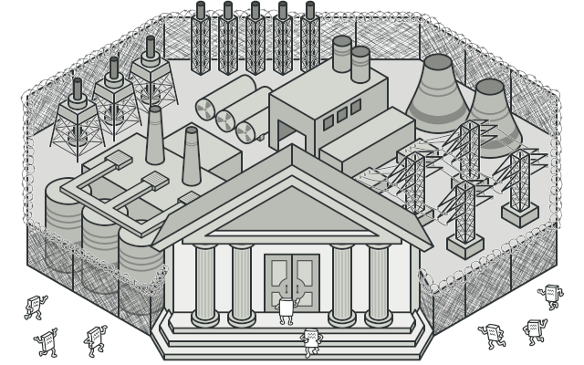
FACADE
Facade is a structural design pattern that provides a simplified interface to a library, a framework, or any other complex set of classes.

Slide 29
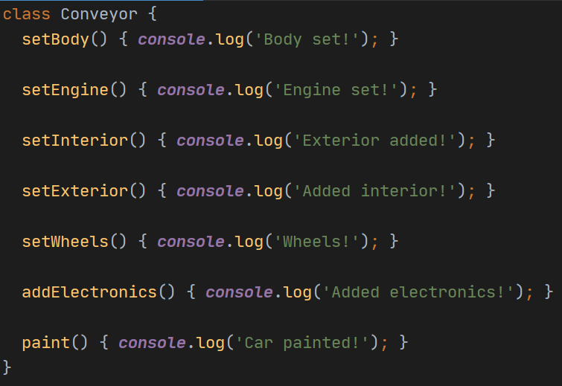
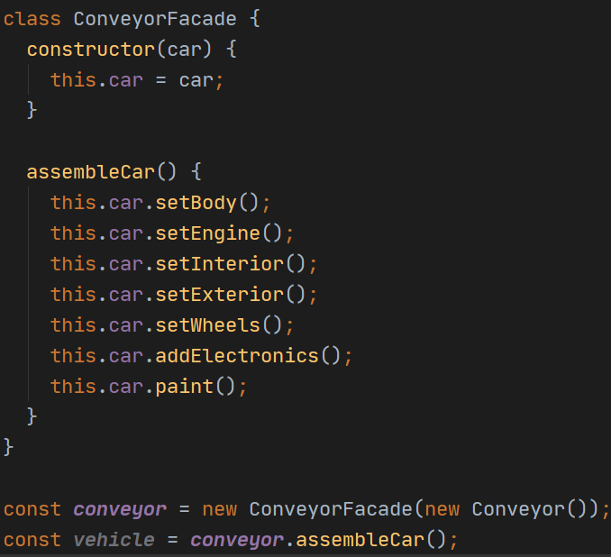
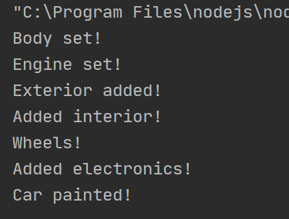
FACADE

Slide 30
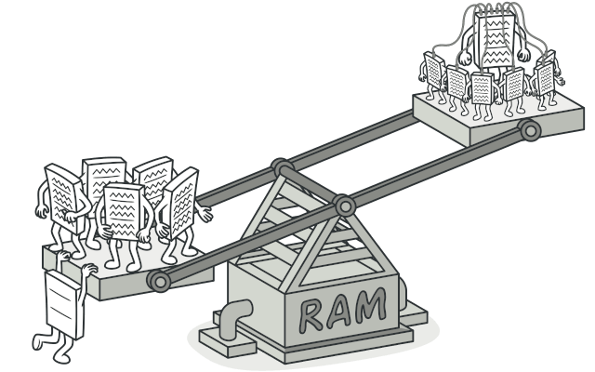
FLYWEIGHT
Flyweight is a structural design pattern that lets you fit more objects into the available amount of RAM by sharing common parts of state between multiple objects instead of keeping all of the data in each object.

Slide 31
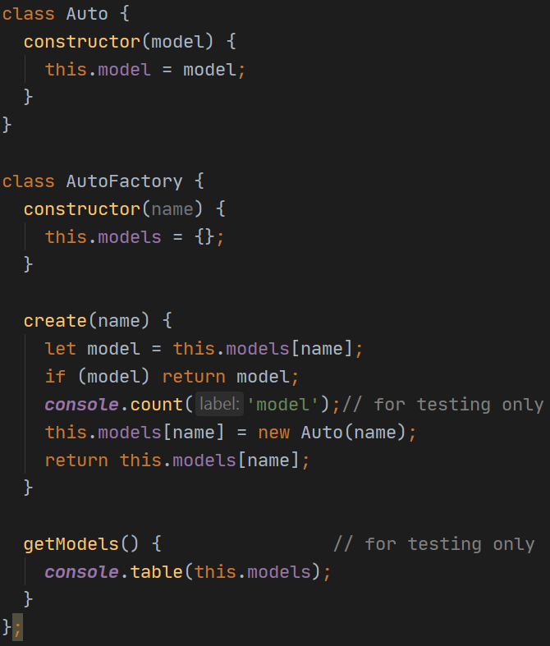
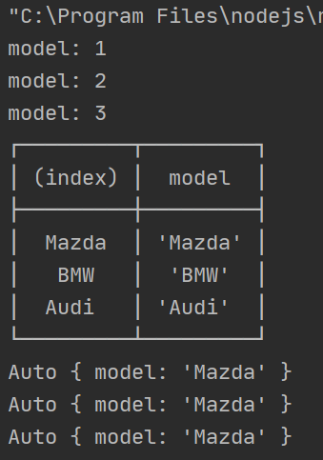

FLYWEIGHT

Slide 32

PROXY
Proxy is a structural design pattern that lets you provide a substitute or placeholder for another object. A proxy controls access to the original object, allowing you to perform something either before or after the request gets through to the original object.

Slide 33



PROXY

Slide 34
BEHAVIORAL PATTERNS
Behavioral patterns take care of effective communication and the assignment of responsibilities between objects.
Behavioral patterns
Chain of Responsibility
Command
Mediator
Iterator
Strategy
Momento
Template Method
Observer
State

Slide 35

MEDIATOR
Mediator is a behavioral design pattern that lets you reduce chaotic dependencies between objects. The pattern restricts direct communications between the objects and forces them to collaborate only via a mediator object.

Slide 36


MEDIATOR

Slide 37

ITERATOR
Iterator is a behavioral design pattern that lets you traverse elements of a collection without exposing its underlying representation (list, stack, tree, etc.).

Slide 38


ITERATOR

Slide 39

CHAIN OF RESPONSIBILITY
Chain of Responsibility is a behavioral design pattern that lets you pass requests along a chain of handlers. Upon receiving a request, each handler decides either to process the request or to pass it to the next handler in the chain.

Slide 40



CHAIN OF RESPONSIBILITY

Slide 41

STRATEGY
Strategy is a behavioral design pattern that lets you define a family of algorithms, put each of them into a separate class, and make their objects interchangeable.

Slide 42


STRATEGY

Slide 43

MEMENTO
Memento is a behavioral design pattern that lets you save and restore the previous state of an object without revealing the details of its implementation.

Slide 44


MEMENTO

Slide 45

TEMPLATE METHOD
Template Method is a behavioral design pattern that defines the skeleton of an algorithm in the superclass but lets subclasses override specific steps of the algorithm without changing its structure.

Slide 46

TEMPLATE METHOD

Slide 47

COMMAND
Command is a behavioral design pattern that turns a request into a stand-alone object that contains all information about the request. This transformation lets you parameterize methods with different requests, delay or queue a request’s execution, and support undoable operations.

Slide 48

COMMAND

Slide 49

OBSERVER
Observer is a behavioral design pattern that lets you define a subscription mechanism to notify multiple objects about any events that happen to the object they’re observing.

Slide 50

OBSERVER

Slide 51

OBSERVER

Slide 52

STATE
State is a behavioral design pattern that lets an object alter its behavior when its internal state changes. It appears as if the object changed its class.

Slide 53


STATE

Slide 54

STATE

Slide 55


